Slide 1

God Uncovered
God’s identity revealed in Jesus Christ
A Wintershall Education Resource. All Rights Reserved.

Slide 2
How to use:
This resource is to be used in conjunction with the Teacher’s Booklet and Bag of Props received following the ‘Life of Christ’ performance at Wintershall.
5 slides are provided for each scene. Each scene can be revisited as an assembly or slot during class time.
Structure for each of the 4 assemblies/slots:
Slide 1 - Choose a prop from the bag – Which scene in the play does this remind you of?
Slide 2 – Remember What happened in this part of the story?
Slide 3 - Listen to the Bible Passage
Slide 4 – Wonder together using the questions provided
Optional extension activity:
Slide 5 – What’s the big idea? Discussion questions that dig deeper into the aspects of God’s character revealed through Jesus in each scene and their implications
BONUS SLIDE:
Slide No. 25 – “What was your most memorable moment?” This slide can be used as a final reflection to help children consider what they personally took from the play.

Slide 3
God Uncovered
God’s identity revealed in Jesus Christ

Slide 4
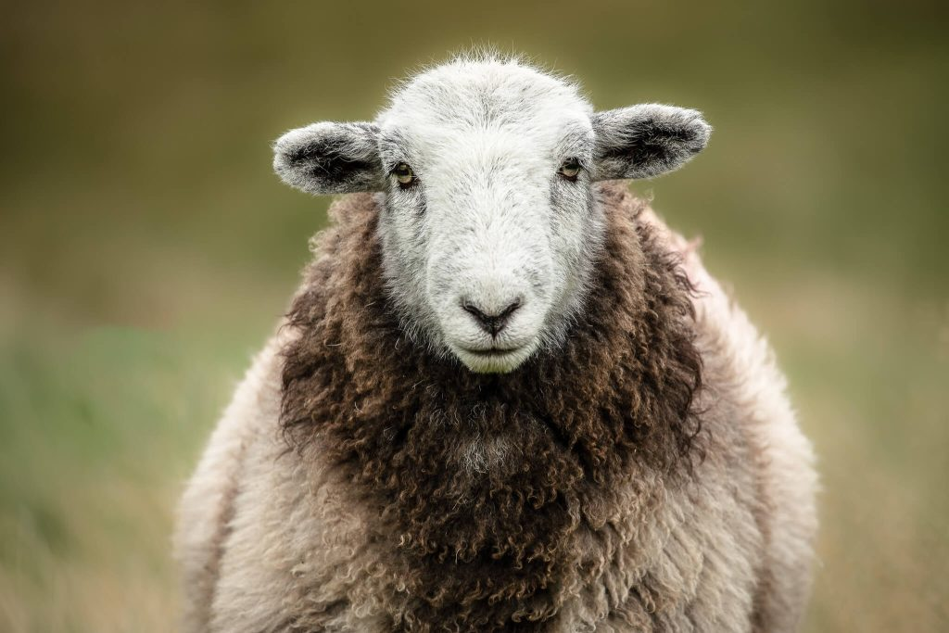
What’s in the wintershall props bag?
Sheep’s Wool

Slide 5
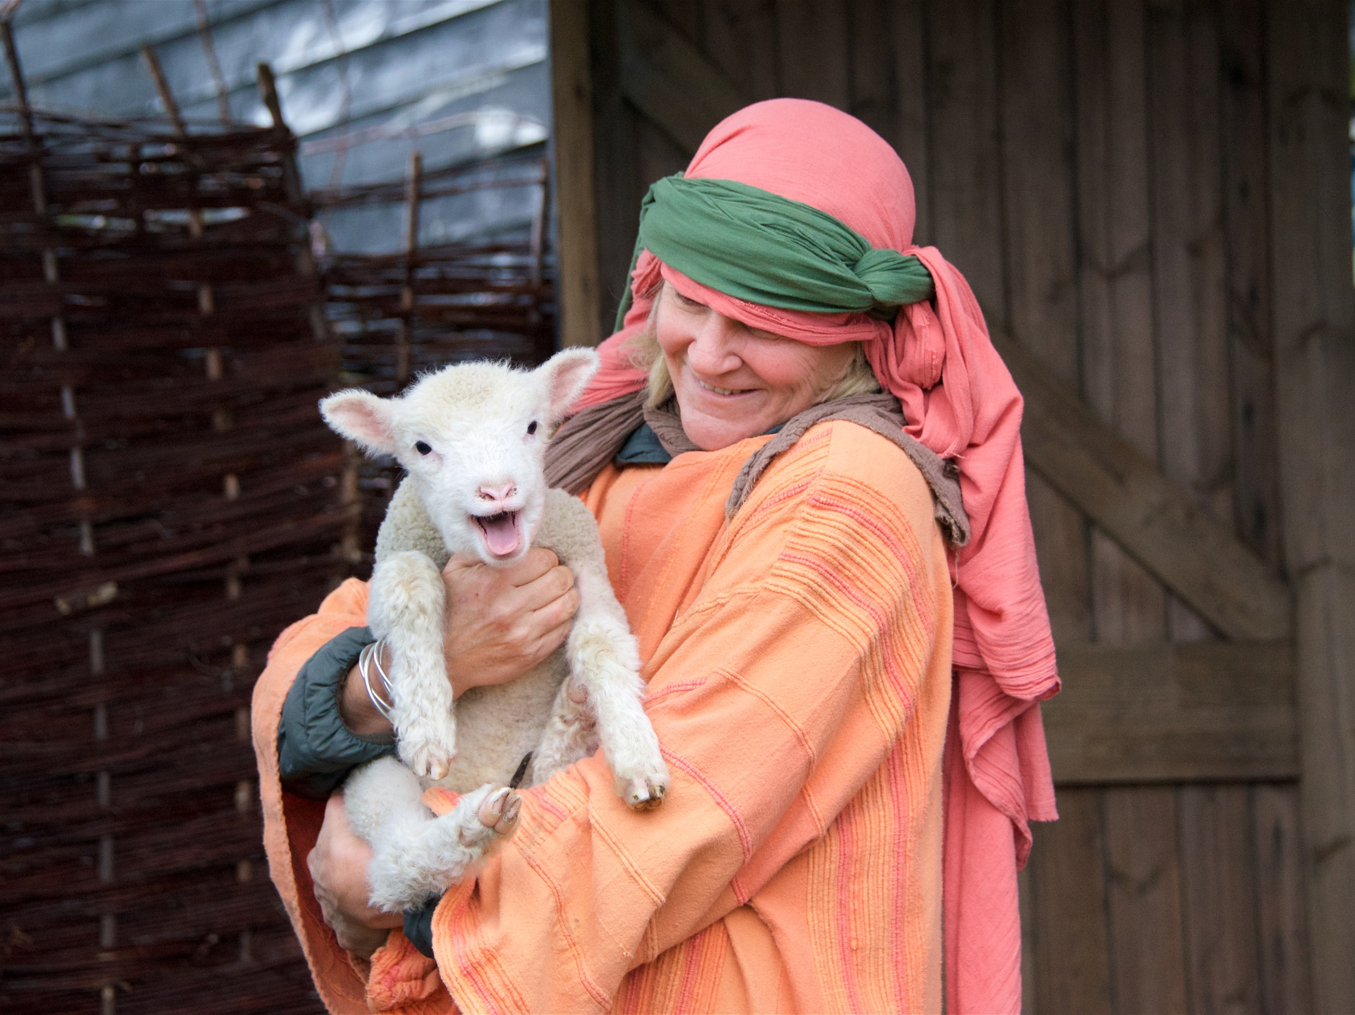
The Shepherds
Act 1 Scene 5
What do you remember?

Slide 6

Luke 2 v 8 - 20
That night, some shepherds were in the fields nearby watching their sheep. An angel of the Lord stood before them. The glory of the Lord was shining around them, and suddenly they became very frightened. The angel said to them, “Don’t be afraid, because I am bringing you some good news. It will be a joy to all the people. Today your Savior was born in David’s town. He is Christ, the Lord. This is how you will know him: You will find a baby wrapped in cloths and lying in a feeding box.” Then a very large group of angels from heaven joined the first angel. All the angels were praising God, saying: “Give glory to God in heaven, and on earth let there be peace to the people who please God.” Then the angels left the shepherds and went back to heaven. The shepherds said to each other, “Let us go to Bethlehem and see this thing that has happened. We will see this thing the Lord told us about.” So the shepherds went quickly and found Mary and Joseph. And the shepherds saw the baby lying in a feeding box. Then they told what the angels had said about this child. Everyone was amazed when they heard what the shepherds said to them. Mary hid these things in her heart; she continued to think about them. Then the shepherds went back to their sheep, praising God and thanking him for everything that they had seen and heard. It was just as the angel had told them.

Slide 7

I wonder….
..why the angel said ‘Do not be afraid’?
..what surprised the shepherds the most?
..what they thought of this baby being the Messiah or Rescuer?
..how Jesus rescues people today?

Slide 8

Jesus reveals God as Rescuer
What’s the Big Idea?
How was Jesus to rescue his people, and what was he rescuing them from?
Why is it significant that the first to hear this good news were poor shepherds?
How do you think meeting Jesus changed how they felt about their future?

Slide 9
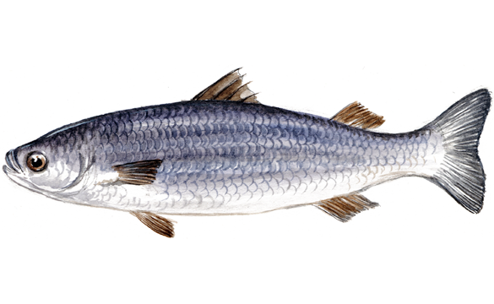
What’s in the wintershall props bag?
A fish from the picnic

Slide 10
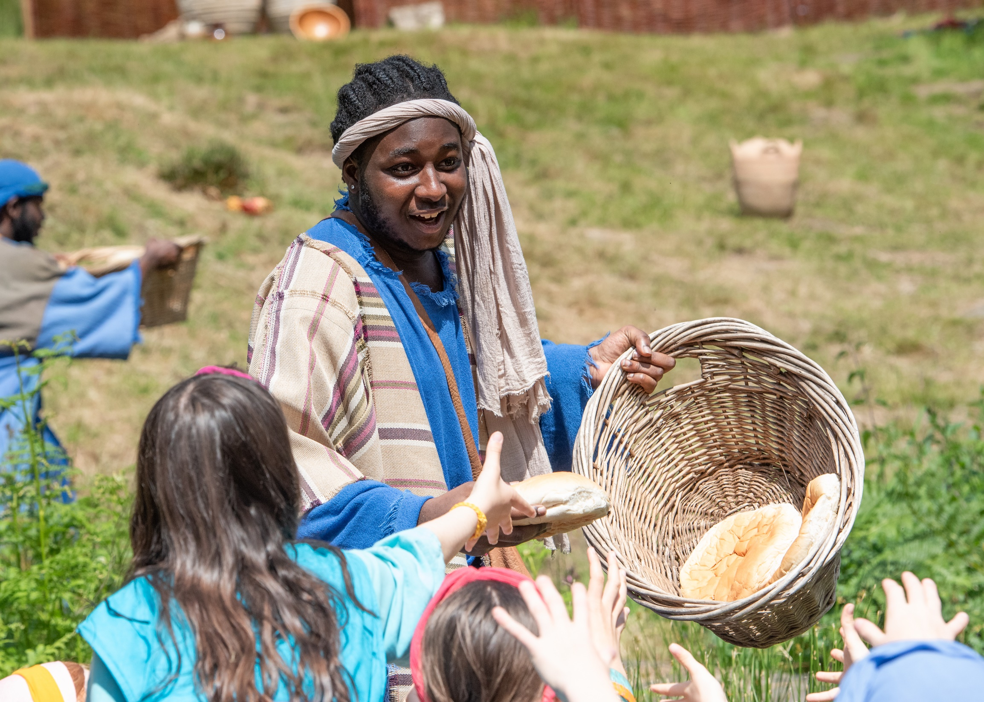
The Boy with a packed lunch
Act 2 Scene 15
What do you remember?

Slide 11
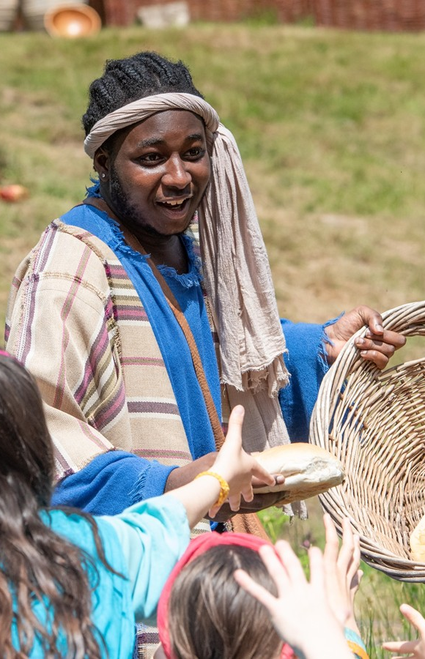
John 6 v 1 - 16
After this, Jesus went across Lake Galilee (or, Lake Tiberias). Many people followed him because they saw the miracles he did to heal the sick. Jesus went up on a hill and there sat down with his followers. It was almost the time for the Jewish Passover Feast. Jesus looked up and saw a large crowd coming toward him. He said to Philip, “Where can we buy bread for all these people to eat?” (Jesus asked Philip this question to test him. Jesus already knew what he planned to do.) Philip answered, “Someone would have to work almost a year to buy enough bread for each person here to have only a little piece.” Another follower there was Andrew. He was Simon Peter’s brother. Andrew said, “Here is a boy with five loaves of barley bread and two little fish. But that is not enough for so many people.” Jesus said, “Tell the people to sit down.” This was a very grassy place. There were about 5,000 men who sat down there. Then Jesus took the loaves of bread. He thanked God for the bread and gave it to the people who were sitting there. He did the same with the fish. He gave them as much as they wanted. They all had enough to eat. When they had finished, Jesus said to his followers, “Gather the pieces of fish and bread that were not eaten. Don’t waste anything.” So they gathered up the pieces that were left. They filled 12 large baskets with the pieces that were left of the five barley loaves. The people saw this miracle that Jesus did. They said, “He must truly be the Prophet who is coming into the world.” Jesus knew that the people planned to come and take him by force and make him their king. So he left and went into the hills alone.

Slide 12
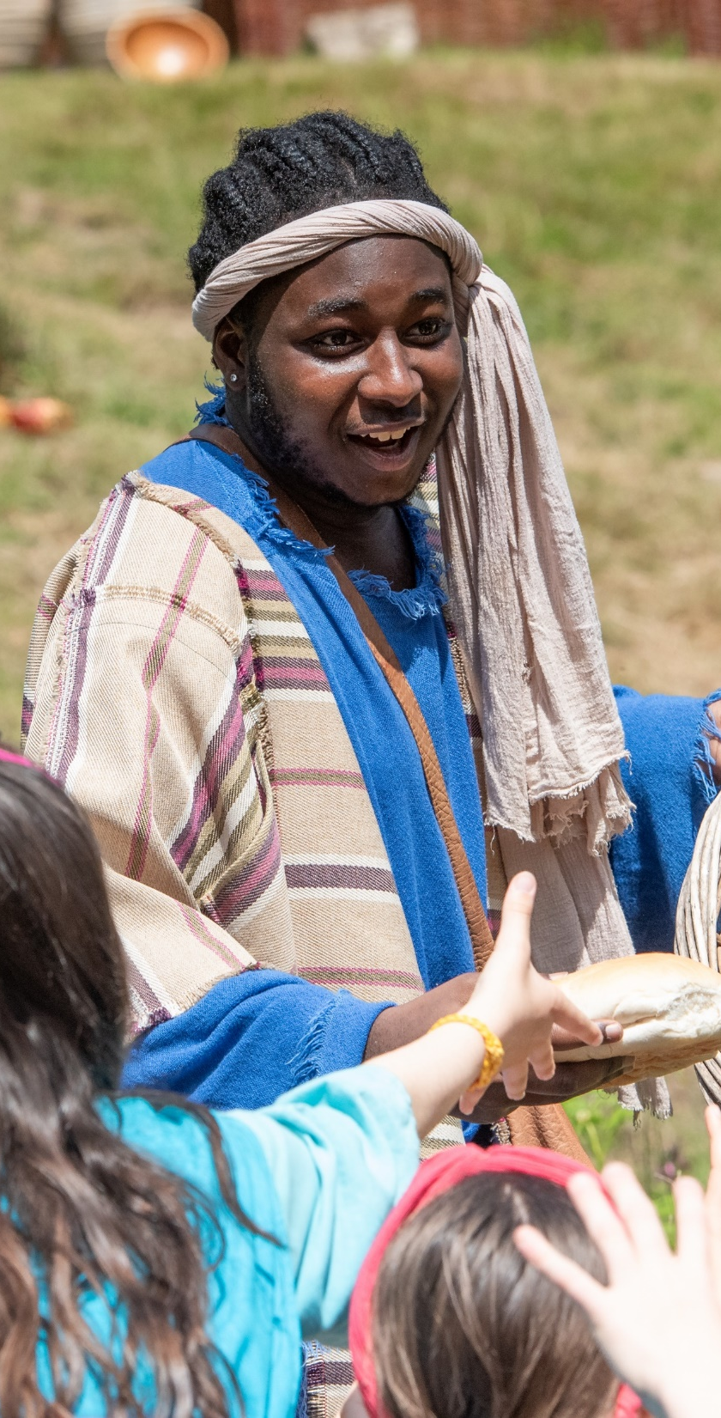
I wonder….
..what the boy with the loaves and fishes was thinking?
..what it would have been like to be part of that crowd?
..how Jesus’ worried disciples felt when they saw the miracle?
..how Jesus provides for people today?

Slide 13

Jesus reveals God as Resourcer
What’s the Big Idea?
What did Jesus want his followers to learn about Him that day?
Our world is full of inequality – how can we share what we have?
Does Jesus expect his followers to have all the answers and be able to do everything themselves?

Slide 14

What’s in the wintershall props bag?
A Palm Leaf

Slide 15
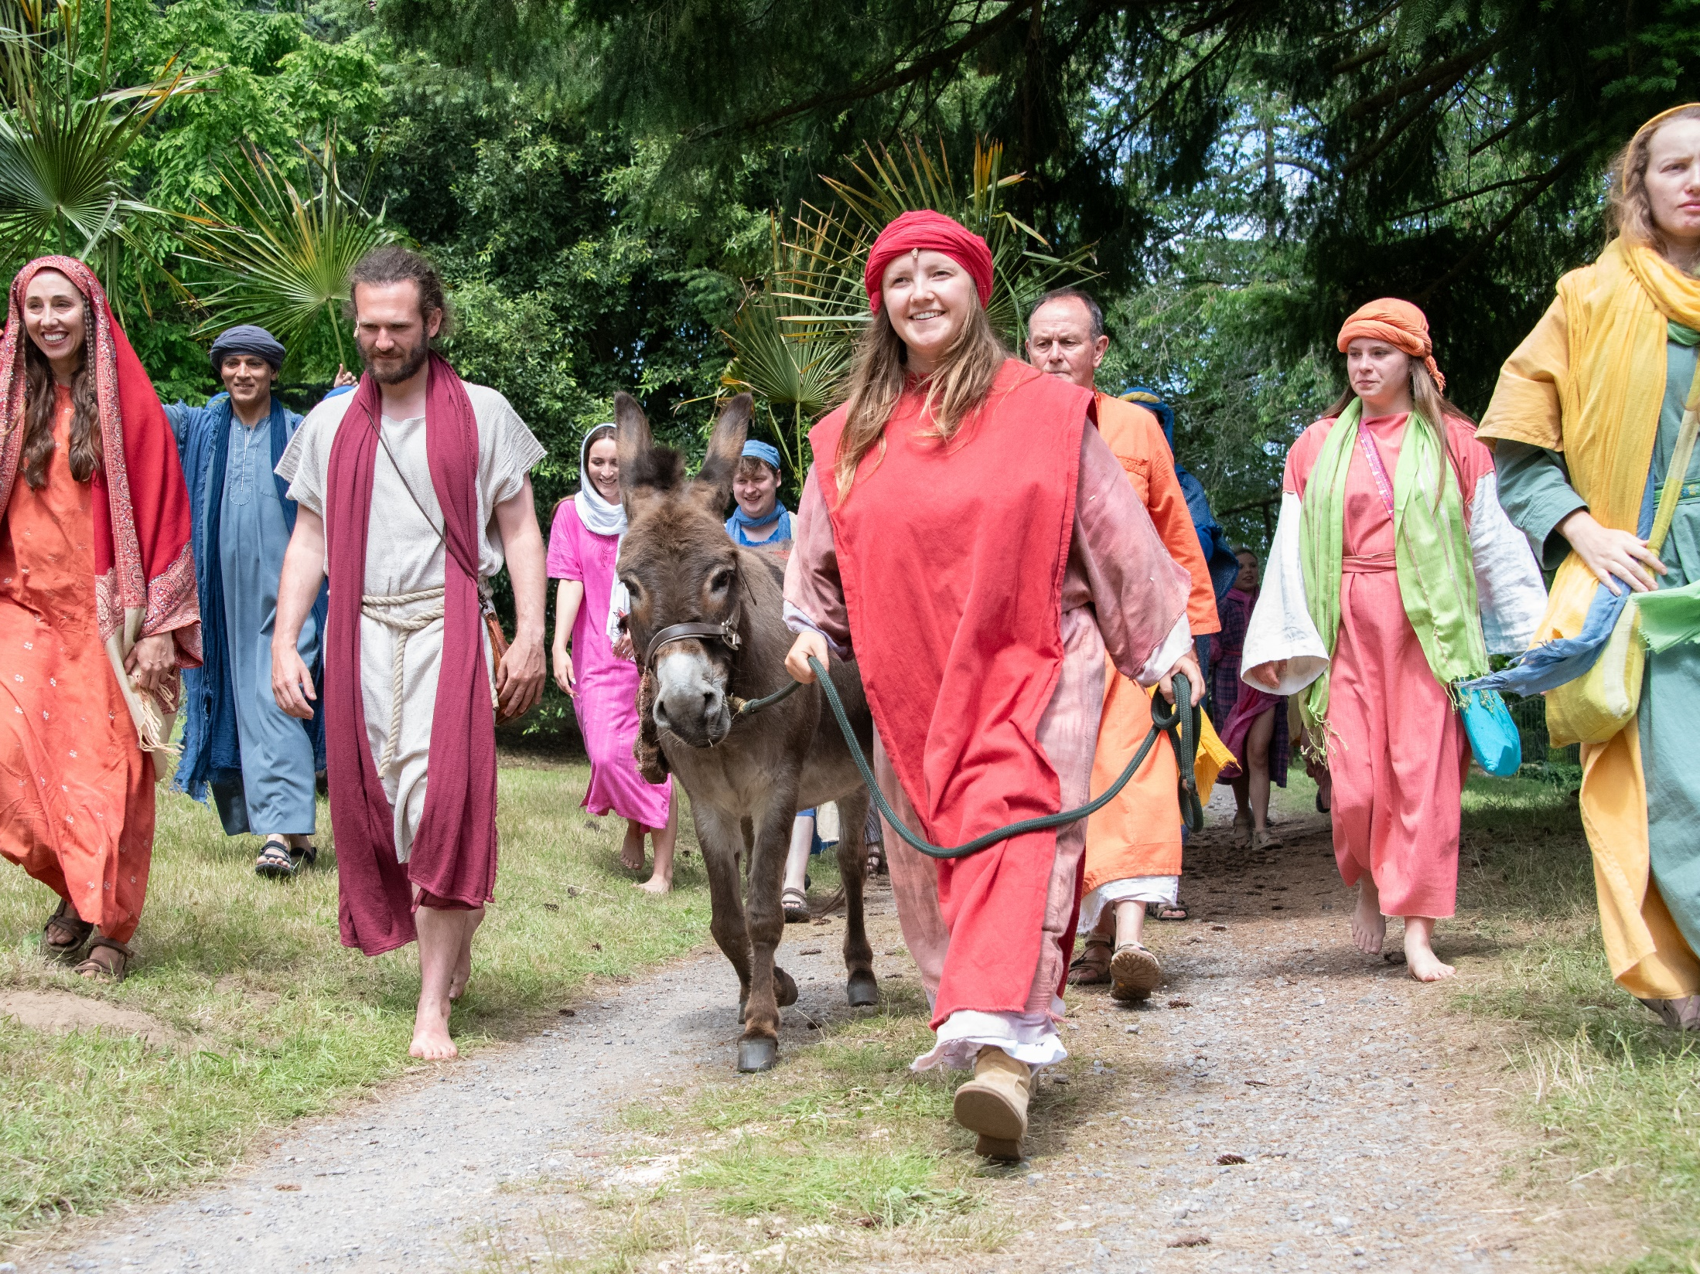
The Crowd in Jerusalem
Act 3 Scene 2
What do you remember?

Slide 16

Luke 19 v 28 – 40
After Jesus said this, he went on toward Jerusalem. Jesus came near Bethphage and Bethany, towns near the hill called the Mount of Olives. Then he sent out two of his followers. He said, “Go into the town you can see there. When you enter it, you will find a colt tied there. No one has ever ridden this colt. Untie it and bring it here to me. If anyone asks you why you are taking it, say, ‘The Master needs it.’” The two followers went into town. They found the colt just as Jesus told them. The followers untied it, but the owners of the colt came out. They asked the followers, “Why are you untying our colt?” The followers answered, “The Master needs it.” So they brought it to Jesus. They threw their coats on the colt’s back and put Jesus on it. As Jesus rode toward Jerusalem, the followers spread their coats on the road before him.
Jesus was coming close to Jerusalem. He was already near the bottom of the Mount of Olives. The whole crowd of followers was very happy. They began shouting praise to God for all the powerful works they had seen. They said, “God bless the king who comes in the name of the Lord! There is peace in heaven and glory to God!” Some of the Pharisees said to Jesus, “Teacher, tell your followers not to say these things!” But Jesus answered, “I tell you, if my followers don’t say these things, then the stones will cry out.”

Slide 17

I wonder….
..why Jesus chose a gentle, humble creature like a donkey to ride on?
..why the crowd were so glad to see Jesus?
..what kind of King Jesus is?
..how Jesus rules today?

Slide 18

Jesus reveals God as Ruler
What’s the Big Idea?
What kind of ‘rules’ did Jesus speak of? What did he say were the greatest 2 commandments? (see Matthew 22 v 34-40 if unsure)
How do societies and communities differ depending on who is in charge?
What would it look like in your life to follow Jesus as your King?

Slide 19
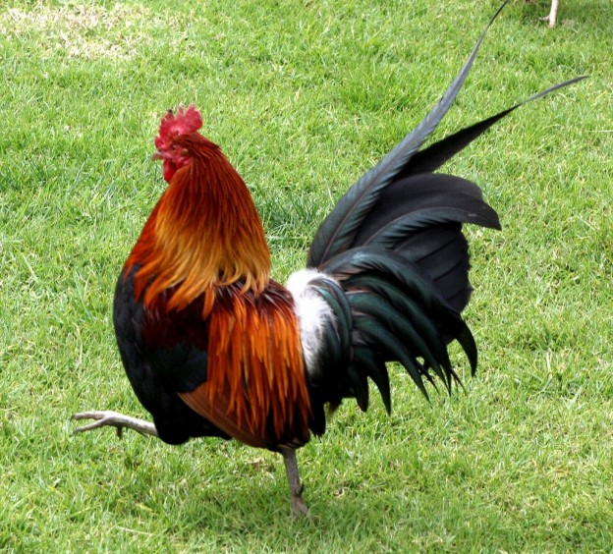

What’s in the wintershall props bag?
A Cockerel Feather

Slide 20
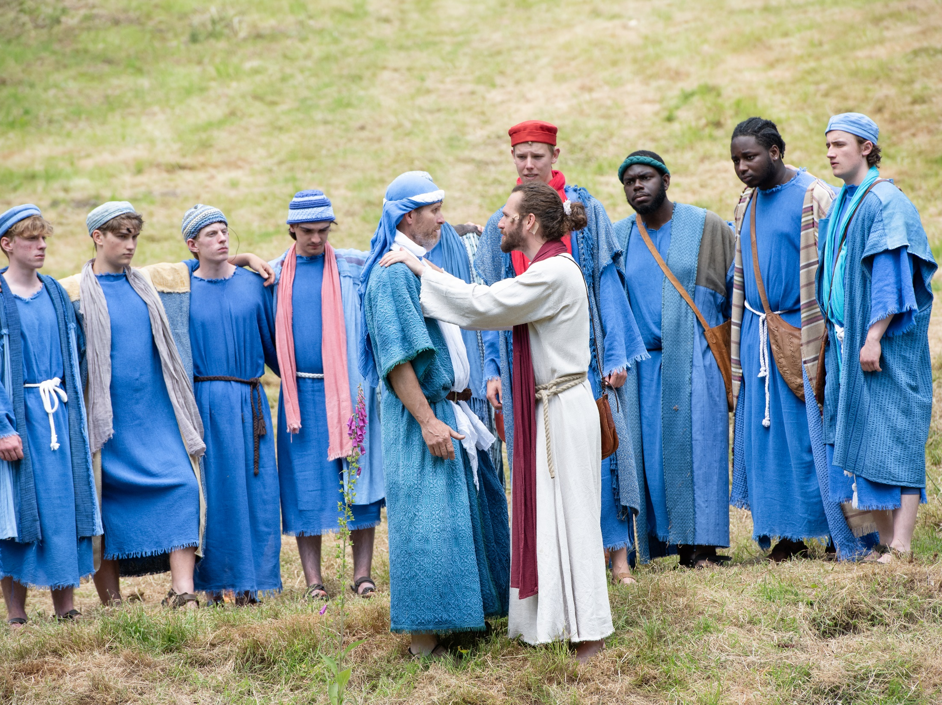
Peter
Act 4 Scenes 3 & 5
What do you remember?

Slide 21

Matthew 26 v 69 - 75
At that time, Peter was sitting in the courtyard. A servant girl came to him and said, “You were with Jesus, that man from Galilee.” But Peter said that he was never with Jesus. He said this to all the people there. Peter said, “I don’t know what you are talking about.” Then he left the courtyard. At the gate, another girl saw him. She said to the people there, “This man was with Jesus of Nazareth.” Again, Peter said that he was never with Jesus. Peter said, “I swear that I don’t know this man Jesus!” A short time later, some people standing there went to Peter. They said, “We know you are one of those men who followed Jesus. We know this because of the way you talk.” Then Peter began to curse. He said, “May a curse fall on me if I’m not telling the truth. I don’t know the man.” After Peter said this, a rooster crowed. Then he remembered what Jesus had told him: “Before the rooster crows, you will say three times that you don’t know me.” Then Peter went outside and cried painfully.

Slide 22

John 21 v 1 – 19
Later, Jesus showed himself to his followers by Lake Galilee. This is how it happened: Some of the followers were together. They were Simon Peter, Thomas (called Didymus), Nathanael from Cana in Galilee, the two sons of Zebedee, and two other followers. Simon Peter said, “I am going out to fish.” The other followers said, “We will go with you.” So they went out and got into the boat. They fished that night but caught nothing. Early the next morning Jesus stood on the shore. But the followers did not know that it was Jesus. Then he said to them, “Friends, have you caught any fish?” They answered, “No.” He said, “Throw your net into the water on the right side of the boat, and you will find some.” So they did this. They caught so many fish that they could not pull the net back into the boat. The follower whom Jesus loved said to Peter, “It is the Lord!” When Peter heard him say this, he wrapped his coat around himself. (Peter had taken his clothes off.) Then he jumped into the water. The other followers went to shore in the boat, dragging the net full of fish. They were not very far from shore, only about 100 yards. When the followers stepped out of the boat and onto the shore, they saw a fire of hot coals. There were fish on the fire, and there was bread. Then Jesus said, “Bring some of the fish that you caught.” Simon Peter went into the boat and pulled the net to the shore. It was full of big fish. There were 153. Even though there were so many, the net did not tear. Jesus said to them, “Come and eat.” None of the followers dared ask him, “Who are you?” They knew it was the Lord. Jesus came and took the bread and gave it to them. He also gave them the fish. This was now the third time Jesus showed himself to his followers after he was raised from death. When they finished eating, Jesus said to Simon Peter, “Simon son of John do you love me more than these?” He answered, “Yes, Lord, you know that I love you.” Jesus said, “Take care of my lambs.” Again Jesus said, “Simon son of John do you love me? He answered, “Yes, Lord, you know that I love you.” Jesus said, “Take care of my sheep.” A third time he said, “Simon son of John do you love me?” Peter was hurt because Jesus asked him the third time, “Do you love me?” Peter said, “Lord, you know everything. You know that I love you!” He said to him, “Take care of my sheep. I tell you the truth. When you were younger, you tied your own belt and went where you wanted. But when you are old, you will put out your hands and someone else will tie them. They will take you where you don’t want to go.” (Jesus said this to show how Peter would die to give glory to God.) Then Jesus said to Peter, “Follow me!”

Slide 23

I wonder….
..why Peter said he didn’t know Jesus?
..what Peter was thinking when he jumped into the water?
..what Jesus meant when he said to Peter ‘Feed my sheep’?
..how Jesus restores people today?

Slide 24

Jesus reveals God as Restorer
What’s the Big Idea?
How does this story help us understand the nature of God’s relationship with those he calls to follow Him?
Here are themes of betrayal, forgiveness and commitment – why are these important things to think about in our communities?
Jesus asked Peter 3 times ‘Do you love me?’ How might this have helped Peter to understand his past actions and his present needs?

Slide 25
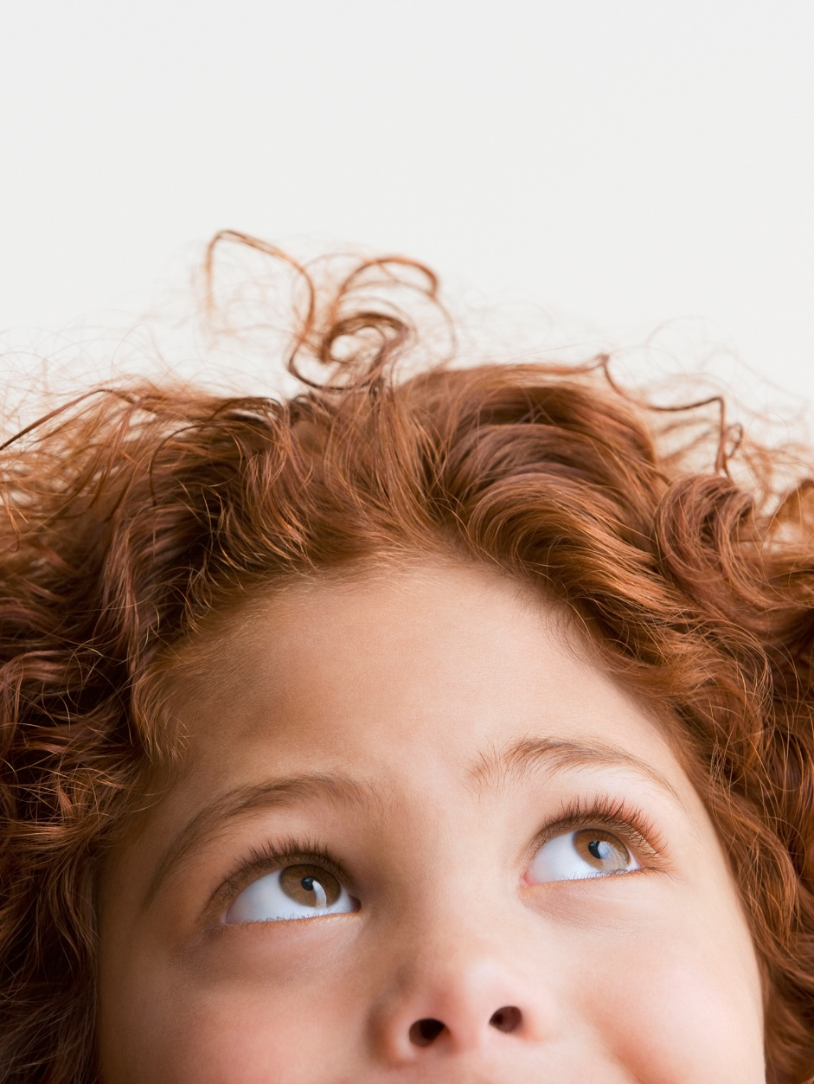
If you could choose a prop from the play to add to the bag, what would you choose and why?
What part of the story would it help you remember?
What did that part of the story teach you about God?
And finally…
“What was your most memorable moment?”

Slide 26


